Slide 1

G.H. Raisoni College of Engineering and Management ,Ahmednagar
Presented by:
Bagban Khizar
Bali Aniket
Shendge Akash
Prof Guide:
Savita Adhav Mam
Voice Based E-Mail System For Blind People

Slide 2

Content
Introduction
Problem Statement
Literature Survey
Motivation
System Requirements & used language
Basic of smtp & imap
Proposed System
System Architecture
DFD LVL : 0
DFD LVL : 1
Use Case Diagram
Mathematical Model
Class Diagram
Advantages & Disadvantage
Conclusion
Future Scope
Reference

Slide 3
Introduction
In world of technology and Internet everything is evolving in
many fields. Internet has made life of people so easy that people
today have access to any information they want easily.
Communication is the one of the main fields highly changed by Internet.
E-mails are the most dependable way of communication over
Internet, for sending and receiving some important information.
But there are certain norm for humans to access the Internet , And
the norm is you must be able to see.
But there are also differently abled people in our society who are not gifted
with what you have. There are some visually impaired people or blind
people who can’t see things and thus can’t see the computer screen or
keyboard

Slide 4
Problem to be solved
A survey has shown that there are more than 240 million visually impaired people around the globe. That is, around 240 million people are unaware of how to use Internet or E-mail. The only way by which a visually challenged person or handicapped person can send an
E-mail is, They have to speak the entire content of the mail to another person( not visually challenged ) and then that third person will compose the mail and send on the behalf of the visually challenged person. But this is not a right way to deal with the problem. It is very unlikely that every time a visually impaired person can find someone for help .

Slide 5
Motivation
Voice based E-mail system which is a web application
which can be used by a Blind person or visually impaired to access E-mails easily and efficiently. The contribution made by this research will help enabled the Blind people as well as Visually impaired peoples , or handicapped
person to send and receive Emails through our webapp
Without even touching a keyboard through IVR
Operations and mouse click

Slide 6
Literature Survey
SR NO | Paper Title | Publication year | Advantage | Disadvantage
1 | “Voice Based System in Mobile Devices for Blind People”. | IEEE 2014 | Easy to use and send Emails | It was only made for Mobile Devices It can only send and recieve emails
2 | “Voice Based Email Reader and Web page Reader | IEEE 2014 | Used to read email through IVR | It was window’s based App’n on which is used only to read email and web page

Slide 7

System Requirement
Processors: Intel® processor i3,i5 etc
Disk space: 2 GB
Operating systems: Windows* 7 ,8 and later
Python* versions: 3.7.X
Python IDE: Pycharm Edu from JetBrains Commutative version
Language Used
Fronted End : Html ,CSS ,Java script
Back End : Django, Ajax
Language Used : Python

Slide 8
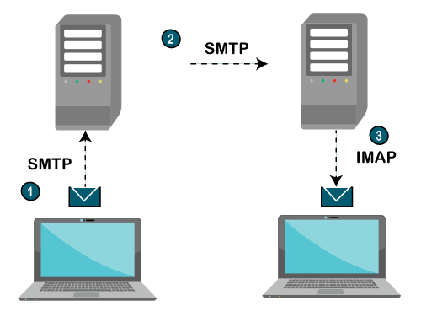
Basic of SMTP & IMAP protocols

Slide 9
Proposed System
The entire structure is based on IVR- interactive voice response.
When using this system the computer will prompt the client to
perform precise operations to gain relevant services
and if the client needs to way in the relevant services then they
need to perform that particular operation.
One of the most important recompense of this system is that user
will not need to use the keyboard.
All operations in the System will be based on voice proceedings.
Sending Email
Reading Email etc

Slide 10
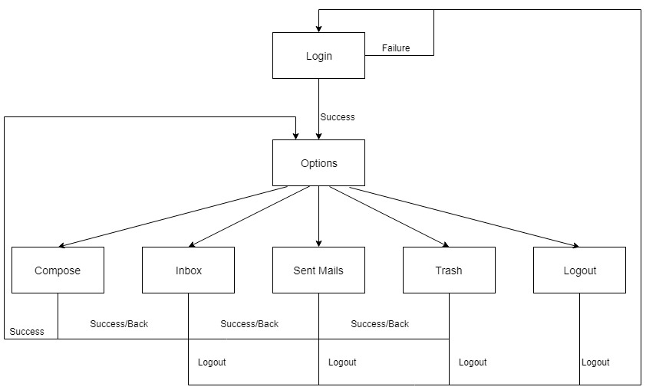
Proposed Architecture of our System

Slide 11
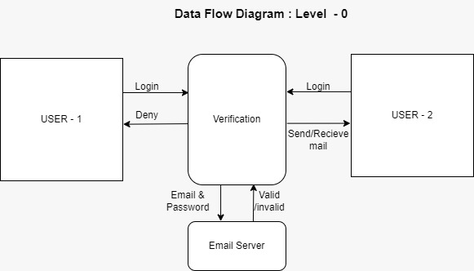
Data Flow Diagram : Level - 0

Slide 12
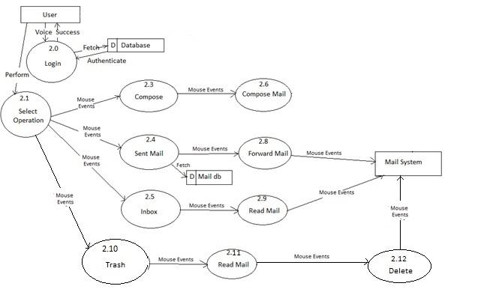
Data Flow Diagram : Level - 1

Slide 13
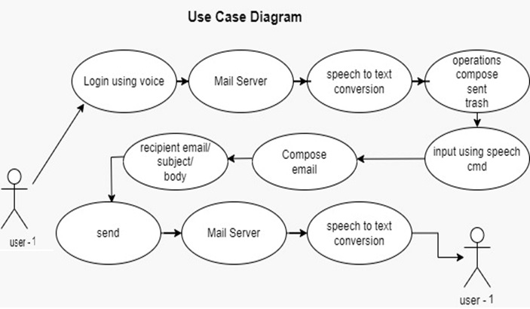
Use Case Diagram

Slide 14
Mathematical Model
Let v be the whole system consist of
V = {I/input , P/process , O/output}
Where ,
I = { Speech Commands like username & password ,Start,
Logout ,Yes or No}
P = { Text to Speech Converter, Speech to Text Converter
Server Encryption ,Server Linking}
O = {Compose Email , Send Email , Delete Email etc.}
Steps 1:User login
Steps 2:User have to select particular task eg: compose, logout
Steps 3: Give user input using IVR
Steps 4:Process the I/O data and perform operations using IVR
Step 5: Logout

Slide 15
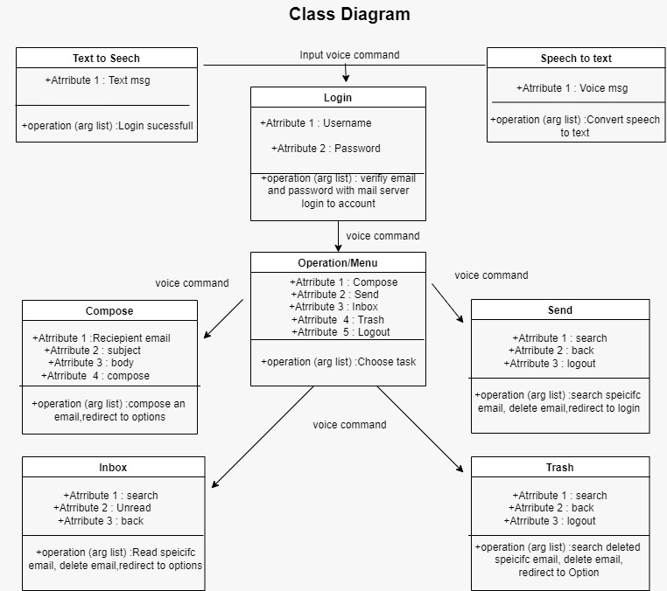
Class Diagram

Slide 16
Advantages
This system makes the disabled
people feel like a normal user.
They can hear the
recently received
mails
The user will have to respond through voice and muse clicks
Use of keyboard is
completely eliminated
The visually impaired people can advance
from Desktop
application to the web based application.

Slide 17
Disadvantages or Drawbacks
User have to take help of third person to give protocol permissions to our
web application only once
2. To Increase Accuracy of Speech or Command Recognition user must need
Headphones

Slide 18
Conclusion
The project that we have projected is a system which will help
the visually impaired people to access email services efficiently. This system will help in overcoming some drawbacks that
were earlier faced by the blind people in accessing emails. We have eliminated the concept of using keyboard shortcuts along with screen readers which will help reducing the cognitive load of remembering keyboard shortcuts. Also any non-sophisticated user who does not know the position of keys on the keyboard
need not bother as keyboard usage is eliminated.

Slide 19
Future Scope
1
2
Voice could be extended
To Buy Product from
Particular Website
Voice could be extended
To book transportation
tickets
3
4
Security Enhancement
Face lock
Using AI & Machine learning
To gain more efficiency

Slide 20
Reference
• Jagtap Nilesh, Pawan Alai, Chavhan Swapnil and Bendre M.R.. “Voice Based System in Mobile
Devices for Blind People”.
In International Journal of Emerging Technology and Advanced Engineering (IJETAE), 2014 on Pages 404-407
(Volume 4, issue 2).
• Ummuhanysifa U.,Nizar Banu P K , “Voice Based Search Engine and Web page Reader”. In International
Journal of Computational Engineering Research (IJCER). Pg 1-5
• The Radicati website. [Online]. Available: http://www.radicati.com/wp/wpcontent/uploads/2014/01/EmailStatistics-Report-2014-2018-Executive-Summary.pdf.
Geeks for geeks

Slide 21
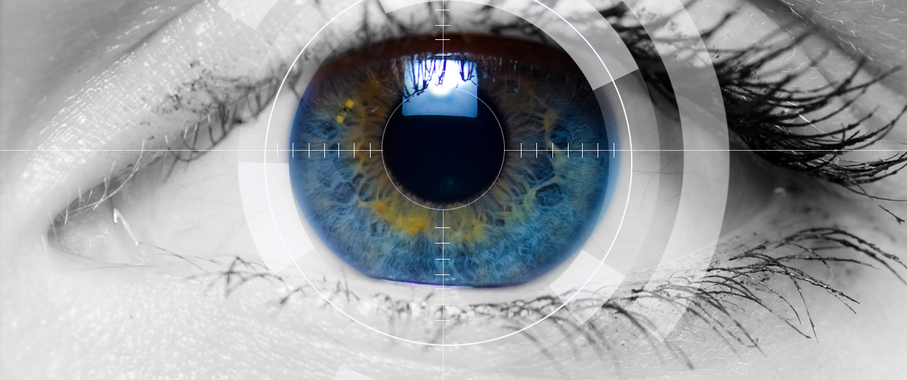
Thank you
Voice Based System For Blind People

